Slide 1
IBM Employee Attrition Analysis
Presenters: Andrew Leonard, Josh Bender, Kayla Yu, Nick Molinare, Yuanqi Mao
Prepared for MSCA-31008, 6/12/2020

Slide 2
Agenda
Background
Variable Definition
Exploratory Data Analysis
Model Development
Results and recommendations

Slide 3
Background and Problem Statement
Background
Variable Definition
Exploratory Data Analysis
Model Methodology
Results
Employee attrition is a key focus area for companies of all sizes and industries
Through predictive people analytics, data scientists can uncover the drivers of attrition and partner with HR teams to find solutions to retain talented employees
Through our analysis, we applied various data mining techniques to the IBM Employee Attrition dataset in order to:
Predict the probability of employee attrition
Identify features that have strong impact on attrition
Determine the cost of employee churn for clustered employee groups

Slide 4
Variable Definitions
Background
Variable Definition
Exploratory Data Analysis
Model Methodology
Results
Work Life Balance
Years at Company
Job Satisfaction
Education
Salary
Features:
Financials- MonthlyIncome, StockOptionLevel…
Job Role- JobLevel, JobRole…
Job Contribution- OverTime, WorkLifeBalance…
Demographics- Age, Gender…
Features Engineered:
Annual Salary
Age Bins
Cost to Replace- Cost_to_replace
Target Variable:
Attrition (Yes / No)
Attrition
Limitations: Our dataset was limited to 1,500 observations, our target variable was unbalanced, and there was no time series component

Slide 5
Exploratory Data Analysis
Background
Variable Definition
Exploratory Data Analysis
Model Methodology
Results
Overall
Feature Analysis
Our data consists of ~1,500 employee records
Our data skews toward individuals who are still employed at the company
Attrition is more prevalent for employees working overtime
Beyond ten years, employees are significantly more likely to remain employed in the following deciles

Slide 6
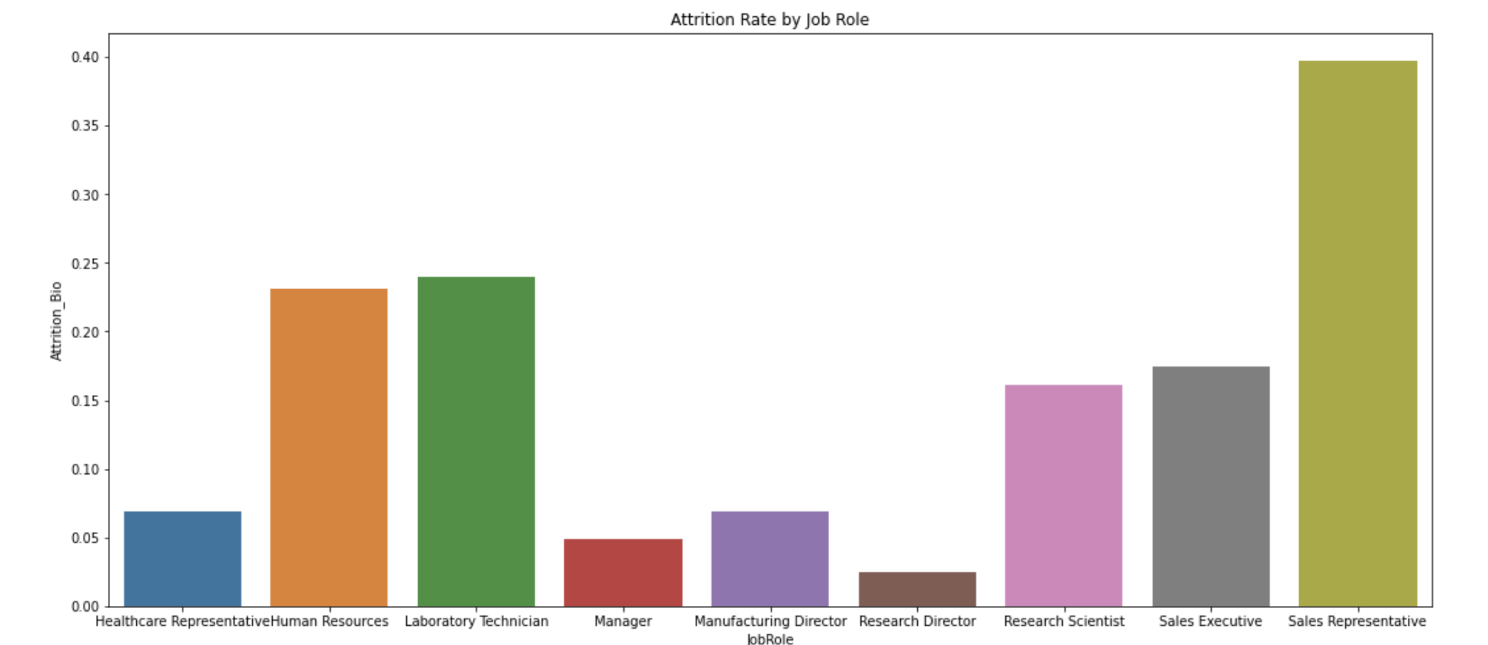
Exploratory Data Analysis
Background
Variable Definition
Exploratory Data Analysis
Model Methodology
Results
In order to quantify the directional impact of employee attrition, we applied a conservative cost estimate of 75% of annual salary^{[1]}
High rates of attrition for sales executives is concerning, given complementary replacement cost
[1] "Managing the Impact of Employee Turnover on Performance: The Role of Process Conformance."

Slide 7
Background
Variable Definition
Exploratory Data Analysis
Model Methodology
Results
Model Methodology
1
Model Preparation
Unsupervised Learning
Description: Divide dataset into four subsets based on feature commonality: demographics, financials, job role, job contribution
Selection: Team alignment of feature characteristics
Justification: Preparation step to prevent individual attributes from over-representation
Description: Cluster each subset and label employees with respective cluster label [repeat for each group] using unsupervised learning algorithms
Selection: PCA and KMeans
Justification: Cluster data of varying shapes and high density of observations
2
Cost Analysis
Supervised Learning
Description: Identify feature insights of high/low churning employees and calculate within cluster attrition cost
Selection: Within cluster mean values and within cluster employee attrition cost
Justification: Quantify expected employee cost to company
Description: Synthetic minority oversampling and supervised learning techniques to avoid oversampling and determine the probability of leaving the company
Selection: SMOTE, Random Forest and Logistic Regression
Justification: Balance dataset and identify feature importance based on high predictive performance algorithm
4
3

Slide 8
Model Preparation
Background
Variable Definition
Exploratory Data Analysis
Model Methodology
Results
Financials
Job Role
Stock Option level
Daily Rate
Hourly Rate
Monthly Rate
Monthly Income
JobRole
JobLevel
Jobsatisfaction
Business Travel
Department
Environment Satisfaction
Work Life Balance
Over Time
Relationship Satisfaction
Job Contribution
Demographics
Job involvement Total working years
Performance Rating Training times last yr
Standard Hours
Years at Company
Years in current role
Years since last promotion
Years with current manager
Age Gender Marital Status Over18
Education Percent Salary Hike
Education Field Employee Count
Employee Number # companies worked
Distance from home

Slide 9
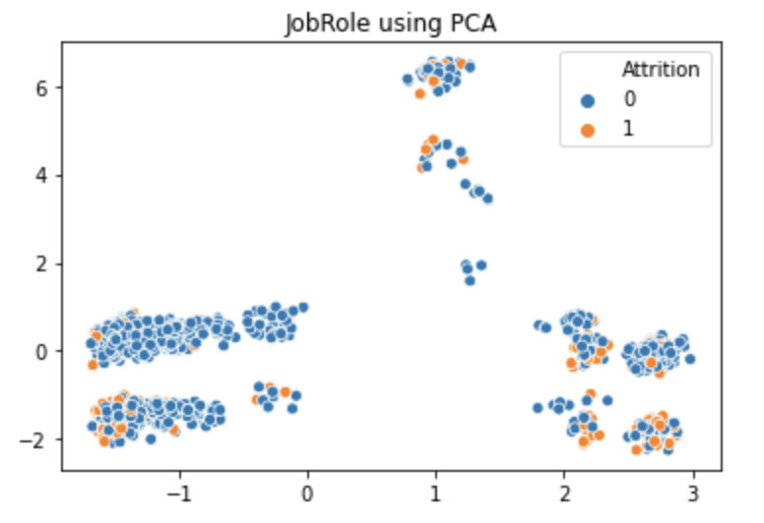
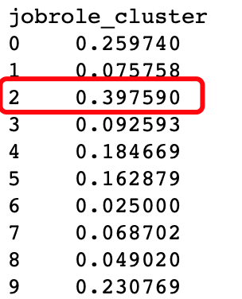
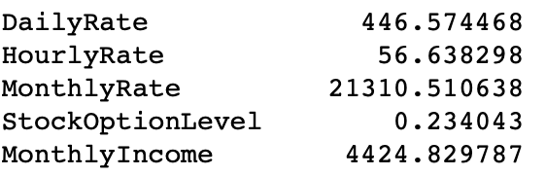
Background
Variable Definition
Exploratory Data Analysis
Model Methodology
Results
Unsupervised Learning Models
First, we applied PCA to each feature subset to determine if any groupings contain a high volume of attrition
Next, we applied KMeans to monitor the percent of attrition per cluster and the corresponding mean values of each feature in the dataset
Finally, we assessed the corresponding mean values of each feature in the dataset for the cluster that demonstrated high attrition

Slide 10
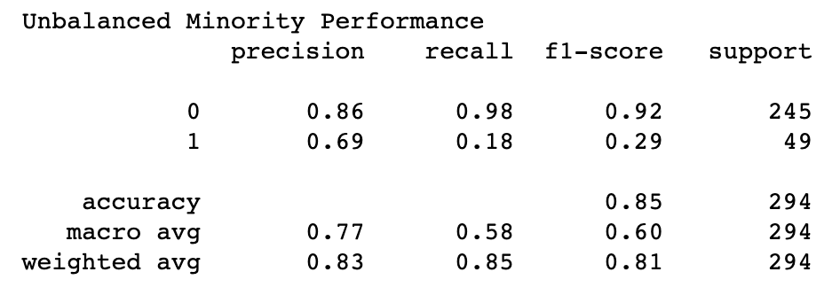
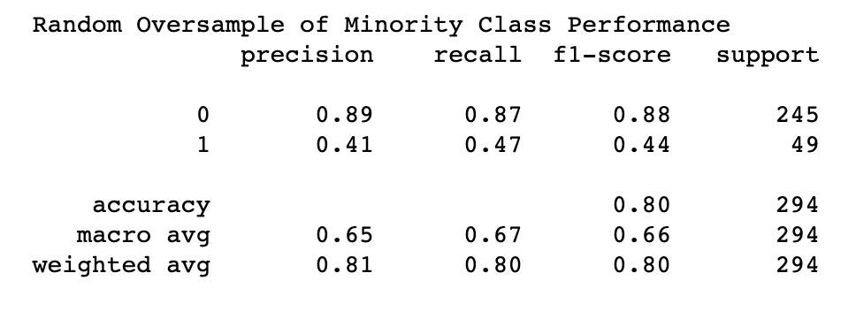
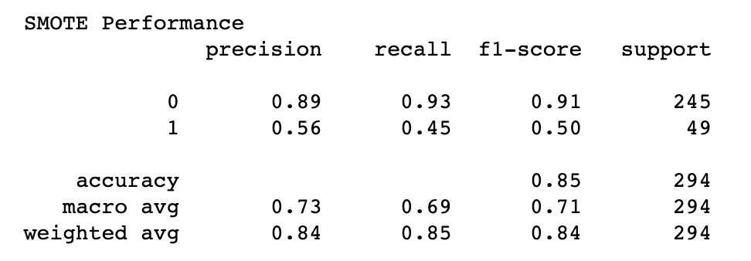
Background
Variable Definition
Exploratory Data Analysis
Model Methodology
Results
Supervised Learning Models
Supervised learning goals: gain insight into employee attrition factors and gather predicted probabilities of attrition for expected cost analysis
Our target variable is highly unbalanced (16% positive class). We implemented a variety of approaches to balance class distribution of employee attrition prior to modeling including Random Oversampling and SMOTE (Synthetic Minority Oversampling Technique)
Next, we initiated logistic regression and random forest algorithms on our balanced data and found significant improvement in recall and F1 score. Recall improved drastically on the random oversample while SMOTE returned the most balanced precision/recall metrics and recorded the highest F1 score.

Slide 11
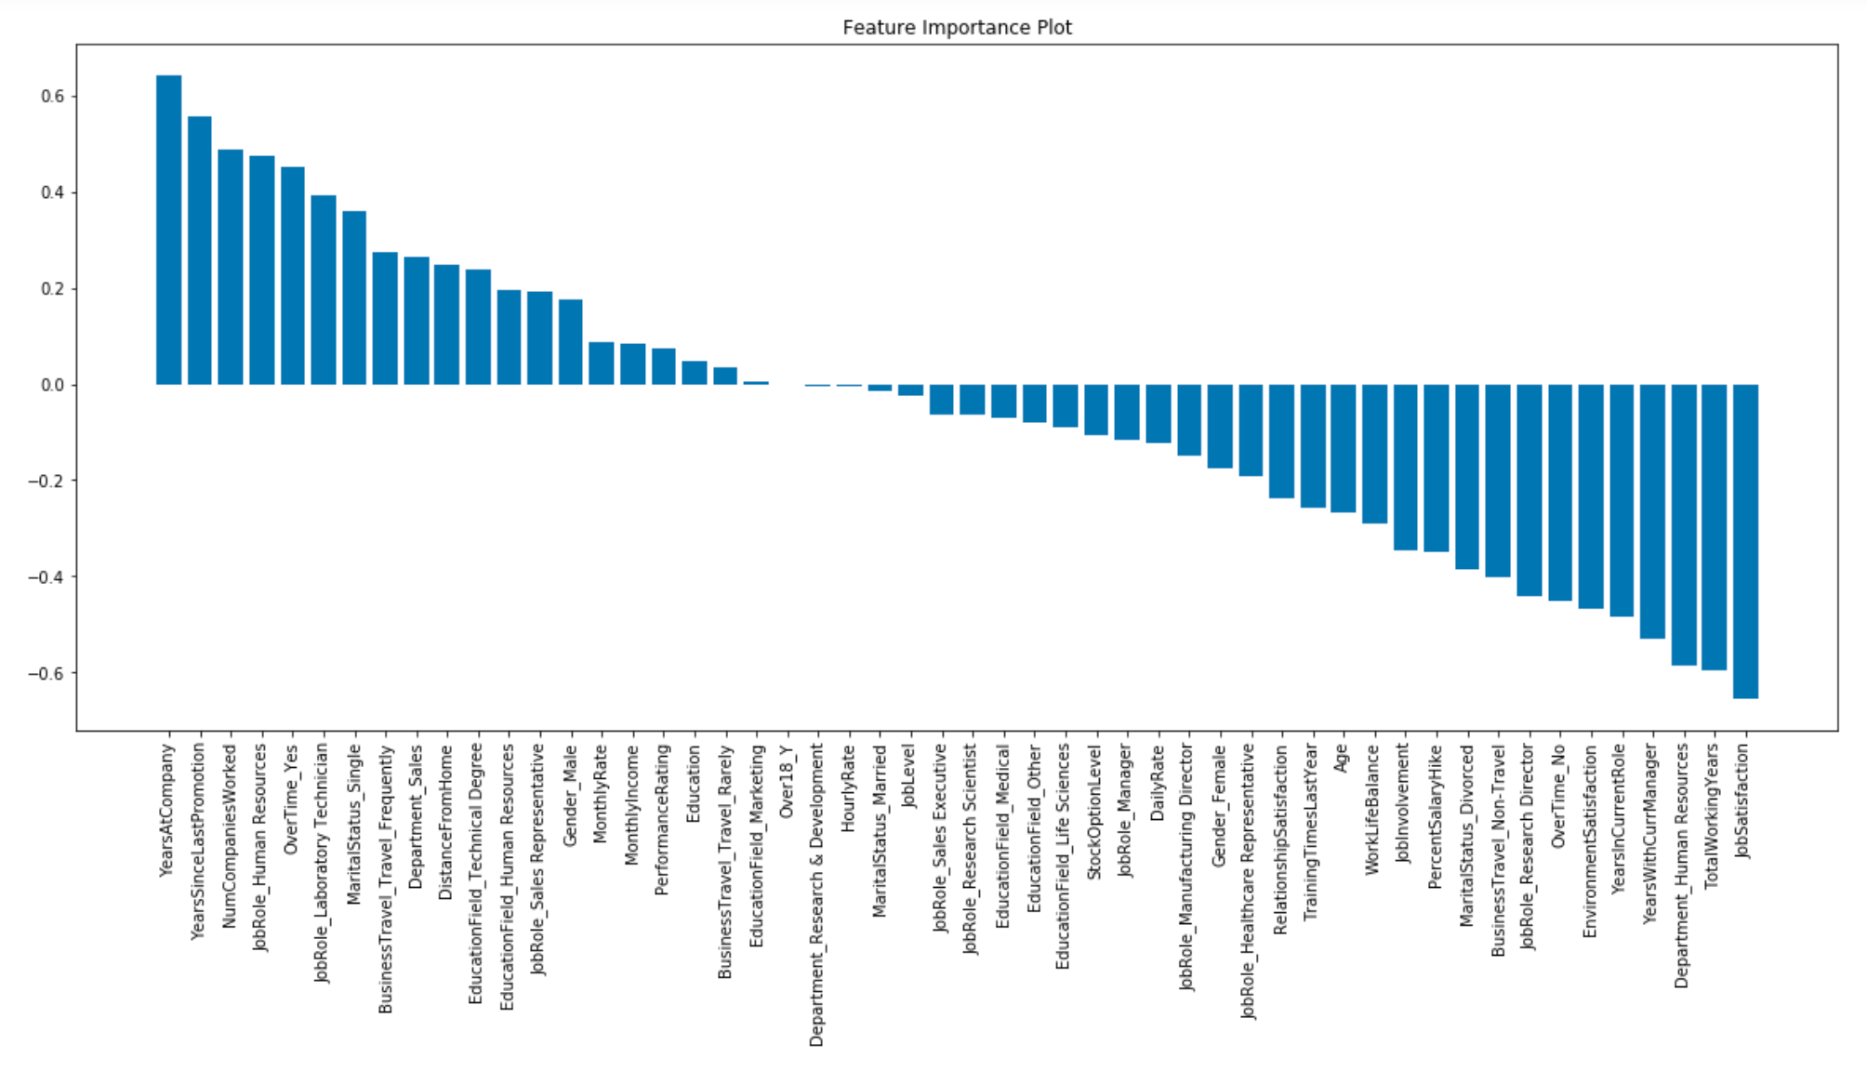
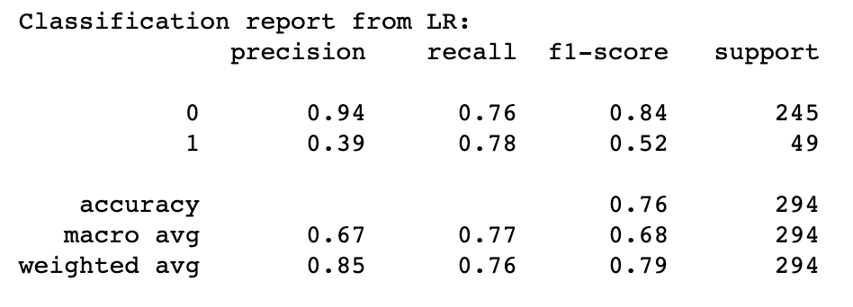
Background
Variable Definition
Exploratory Data Analysis
Model Methodology
Results
Supervised Learning Models, cont'd
In addition, we tried Logistic
Regression model to compare
its performance with RF, also trying to explore the direction of effect for each variable, as shown in the figure
The following table shows the classification report of LR model

Slide 12
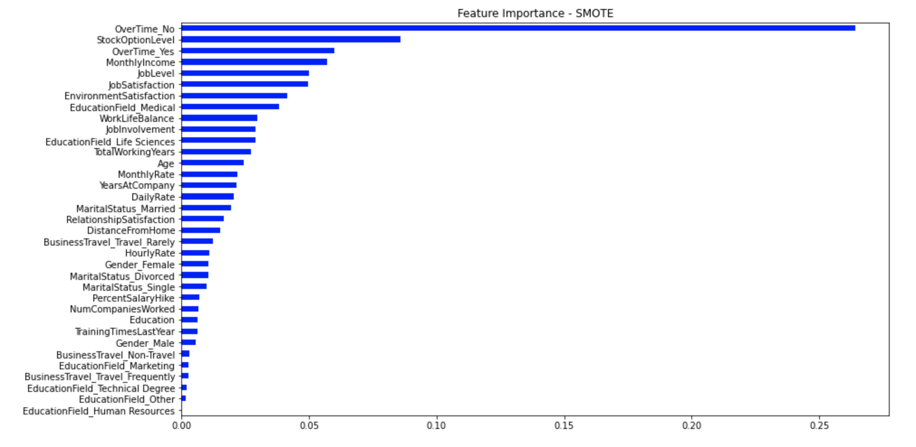
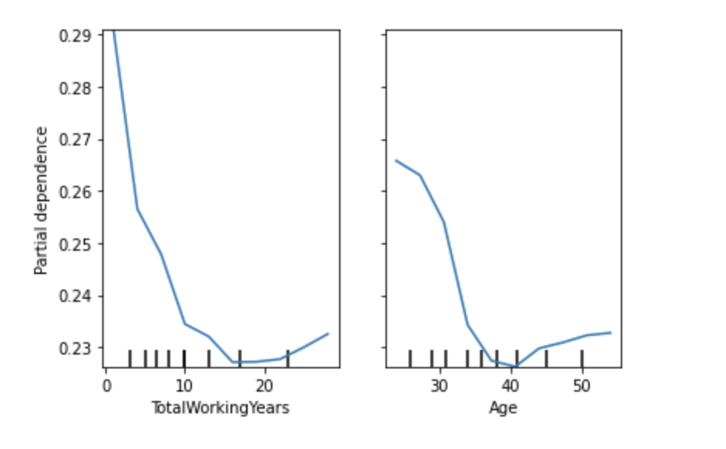
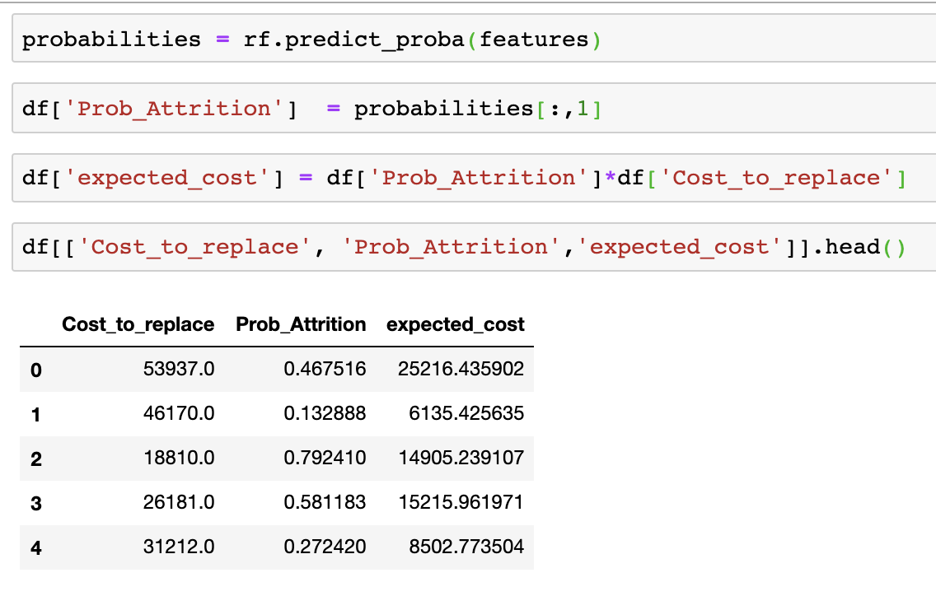
Background
Variable Definition
Exploratory Data Analysis
Model Methodology
Results
Supervised Learning Models, cont'd
The random forest with SMOTE was our selected model as it handled our categorical data and generalized well.
We used feature importance and partial dependency plots to better understand employee attrition and make data driven recommendations.
Finally, we used the predicted probability of attrition for each employee using our RF model to calculate the expected cost of attrition.

Slide 13
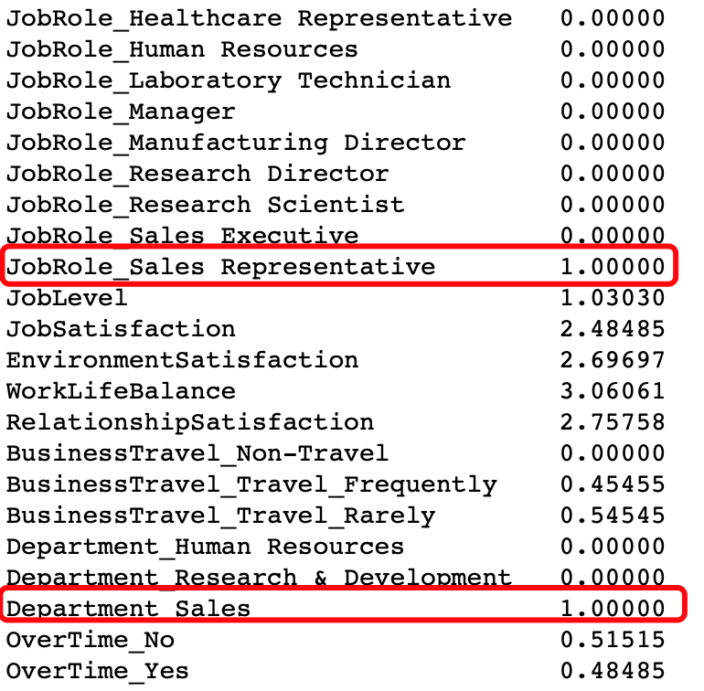
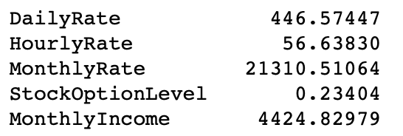
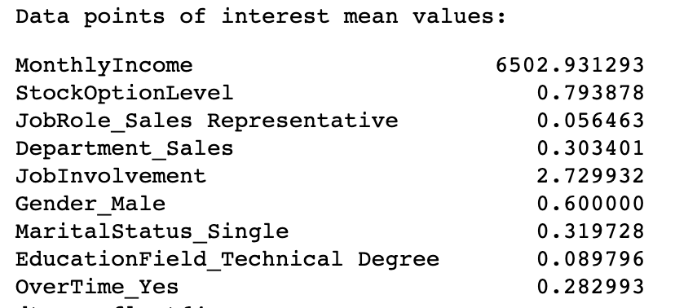
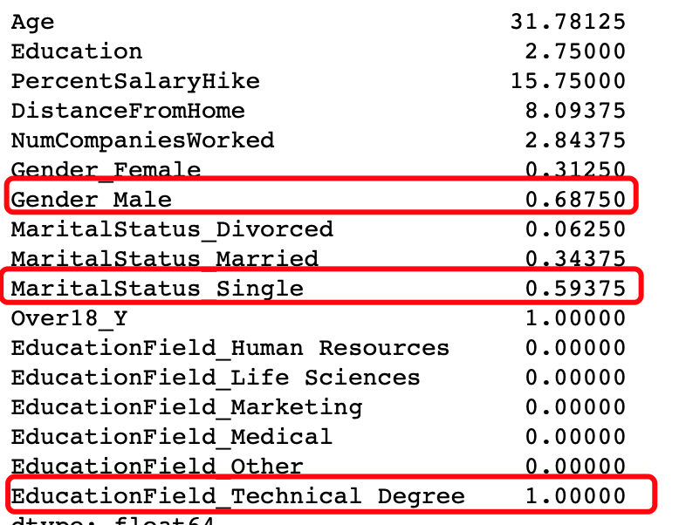
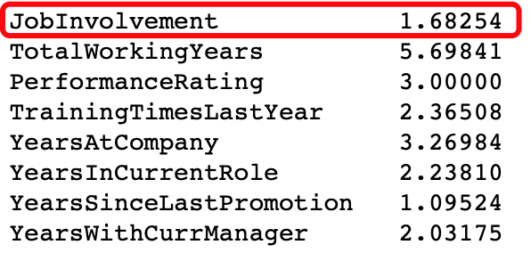
Results and Implications
Background
Variable Definition
Exploratory Data Analysis
Model Methodology
Results
Feature Mean Value: Highest Attrition Cluster
Feature Mean Value: Total Dataset
Financials
Job Role
Job Contribution
Demographics

Slide 14
Results and Implications
Background
Variable Definition
Exploratory Data Analysis
Model Methodology
Results
Financials
Job Role
Employees who leave make 32% less than the average employee and receive 71% lower stock options
Sales Representatives have a higher propensity to leave the company
Low job involvement leads to attrition as employees who leave the company have 38% lower job involvement than the average
Employees who are male, single, and have technical degrees experience higher attrition than the average employee
Job Contribution
Demographics

Slide 15
Summary and Next Steps
Background
Variable Definition
Exploratory Data Analysis
Model Methodology
Results
Features and Attrition
Employees working overtime is a major attrition factor
Young, single, and entry level employees are tougher to keep around
Low annual income and absence of stock options is associated with higher attrition
Overall job satisfaction and employee morale is connected to attrition
Expected Cost Analysis by Employee Group – Future State
With additional data from IBM we can identify specific employee groups with both high likelihood of attrition and high cost to IBM
Current data does not have enough information about the employees leaving to make confident assessments
Recommendations
Digging into overtime:
Why are employees working overtime?
Opportunities to improve company efficiencies to reduce demand?
Cost analysis:
Addressing salaries and OT policies to reduce overall cost to attrition
Review financial incentives for entry level potions
Company Culture:
What is causing the lower morale in the employees
How does IBM improve their employees job satisfaction.

Slide 16
Appendix
Appendix

Slide 17
Complete Set of Features
Appendix

Slide 18
Background
Variable Definition
Exploratory Data Analysis
Model Methodology
Results
Quantify Employee Cost
Financials
Team: Please Review and add results for your dimensions
Job Role
Job Contribution
Demographics

Slide 19
References
References
Ton, Zeynep, and Robert S. Huckman. "Managing the Impact of Employee Turnover on Performance: The Role of Process Conformance." Organization Science 19, no. 1 (January–February 2008): 56–68.
Fecheyr-Lippens, Bruce, et al. “Power to the New People Analytics.” McKinsey & Company, 1 Mar. 2015, www.mckinsey.com/business-functions/organization/our-insights/power-to-the-new-people-analytics.
McFeely, Shane and Wigert, Ben. “This Fixable Problem Costs U.S. Businesses $1 Trillion.” www.gallup.com/workplace/247391/fixable-problem-costs-businesses-trillion.aspx#:~:text=The%20cost%20of%20replacing%20an,to%20%242.6%20million%20per%20year.

